Slide 1
INTEGRATED CAPSTONE PROJECT
BATCH C GROUP 4
Check Point 1
Prantik Singh Chauhan | Bhavya Samhitha Mallineni | Rajiya Proddatur | Neha | Swikriti Das
Data Manipulation using python | Derived the key drivers | Understanding and working on the problem statements | Creation of ER diagram | Creation of Database for the problem statements
Descriptive statistics and hypothesis testing |  |  | Analysis using SQL Oracle query

Slide 2

HR Analytics
HRWorks Pvt Ltd is facing a challenge with new hires
30% of the candidates who accept the job offer do not join the company.
This leads to huge loss of revenue and time as the companies initiate the recruitment process again to fill the workforce demand.
Our aim is to build a model that identifies the candidates in advance, who will not join. This saves the company from wasting their resources

Slide 3
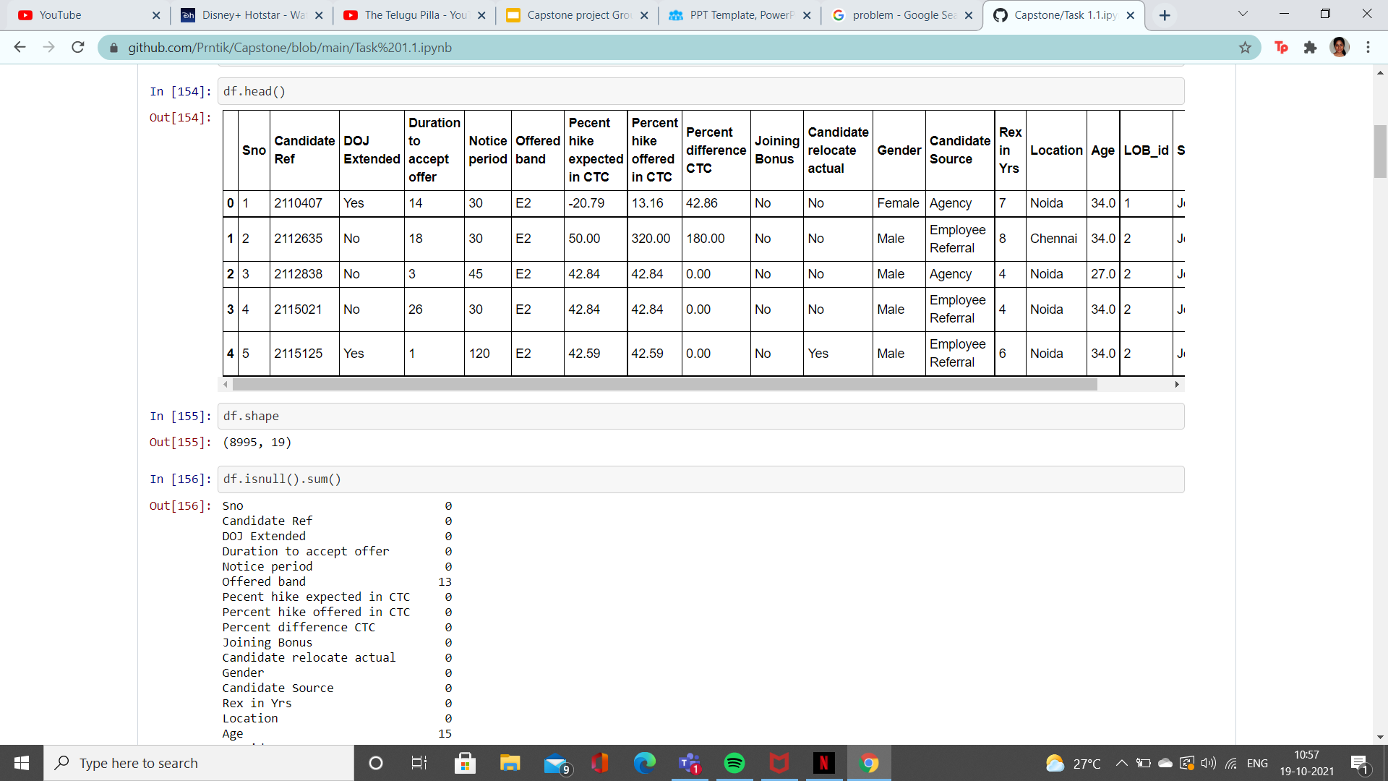
TASK 1.1 (Data Manipulation using Python)
This is the dataset having details of candidates who were offered the job

Slide 4
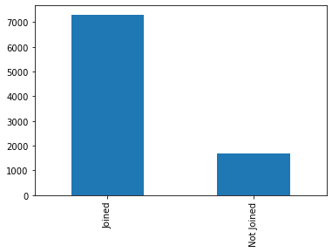
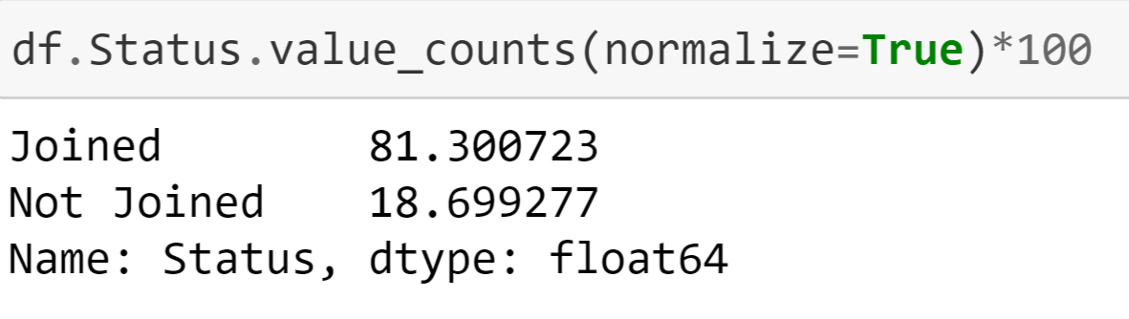
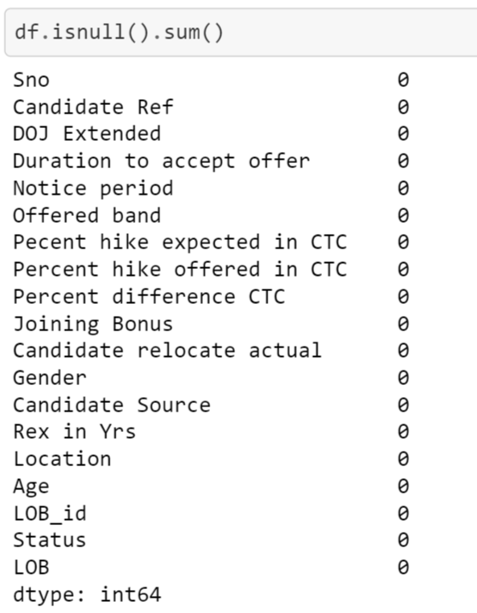
81% candidates who were offered joined
The initial dataset had 13 null values in offered band and 15 null values in Age
We manipulated the data and removed the null values using mode and median functions

Slide 5
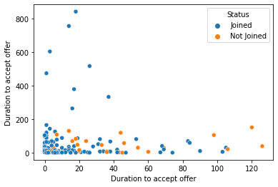
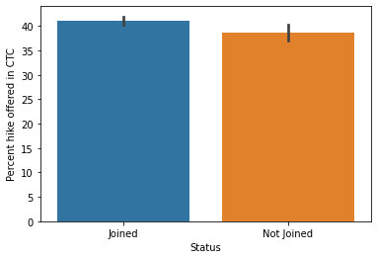
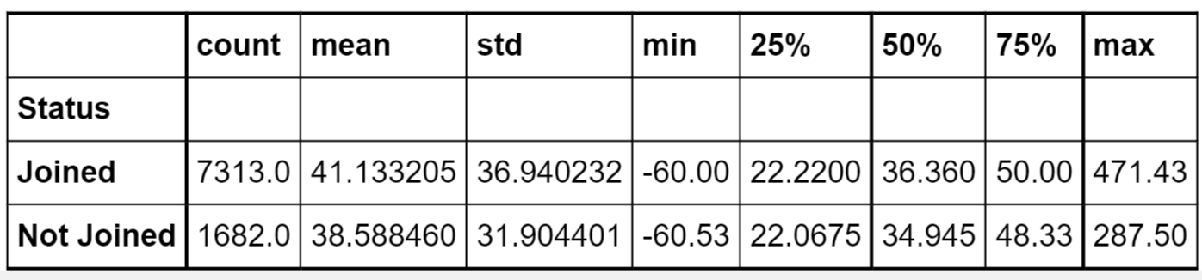
Key Drivers and their influence on candidate joining status:
Duration to accept offer:
From the above shown data we can observe the following:
-> The candidates who has duration less than 20 days are most likely to join
-> the candidates having the duration above 100 are most liket to not join
Percentage of Hike offered:
From the above data we can observe that the people who have joined the firm has almost 2% more hike.

Slide 6
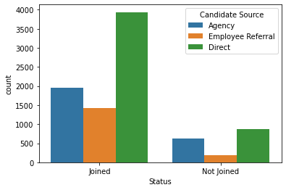
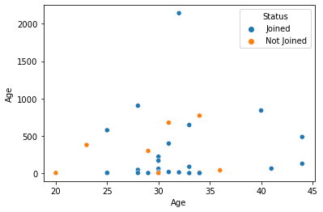
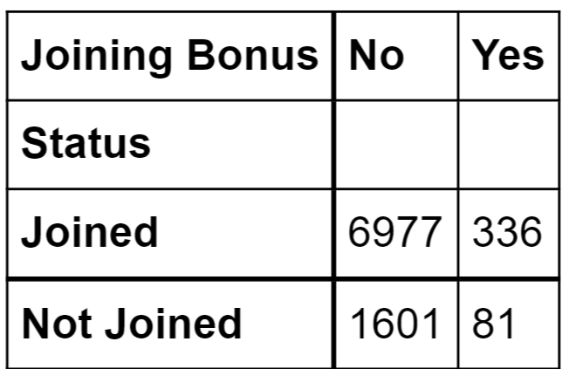
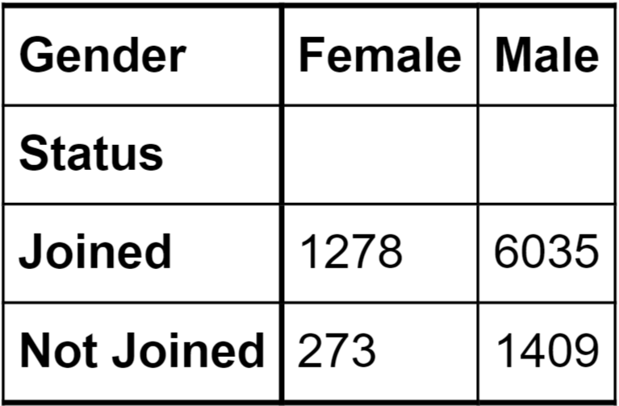
Candidate Source:
According to the observation candidate source the chances of candidate joining the company is greater if he comes from employee referral.
Age:
From the above shown data it states:
The candidates below 25 are likely to not join
the candidates above the age of 35 are more likely to join the company
Joining Bonus:
Does act as a key driver.
Gender:
Does act as a key driver.

Slide 7
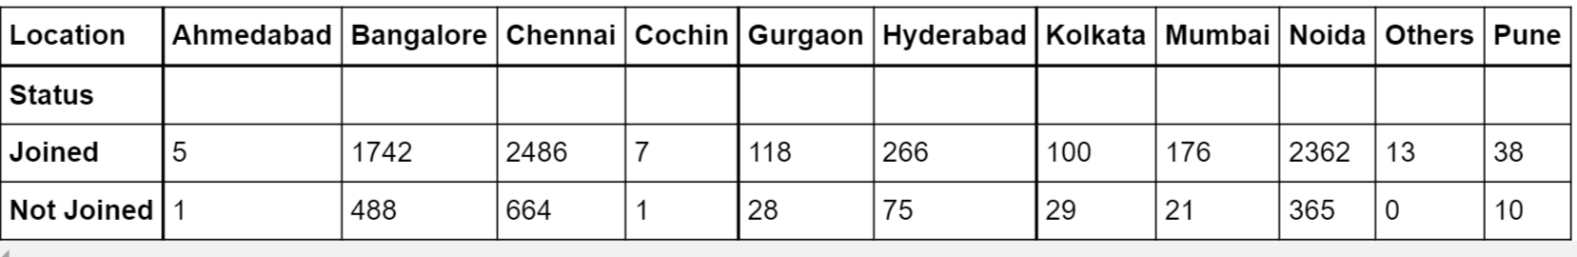
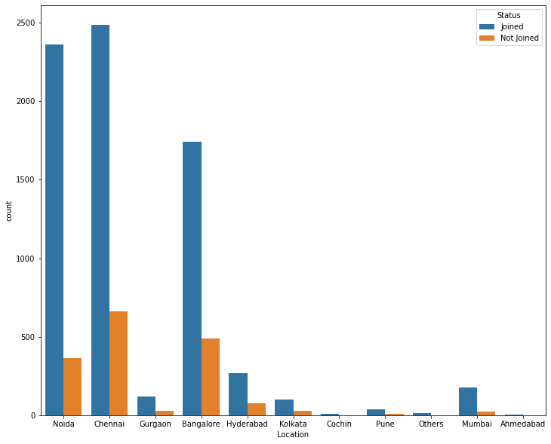
Location:
Location is influencing the joining status as for each city, we can observe that candidate joining Noida, Chennai and bangalore is much greater than other cities

Slide 8
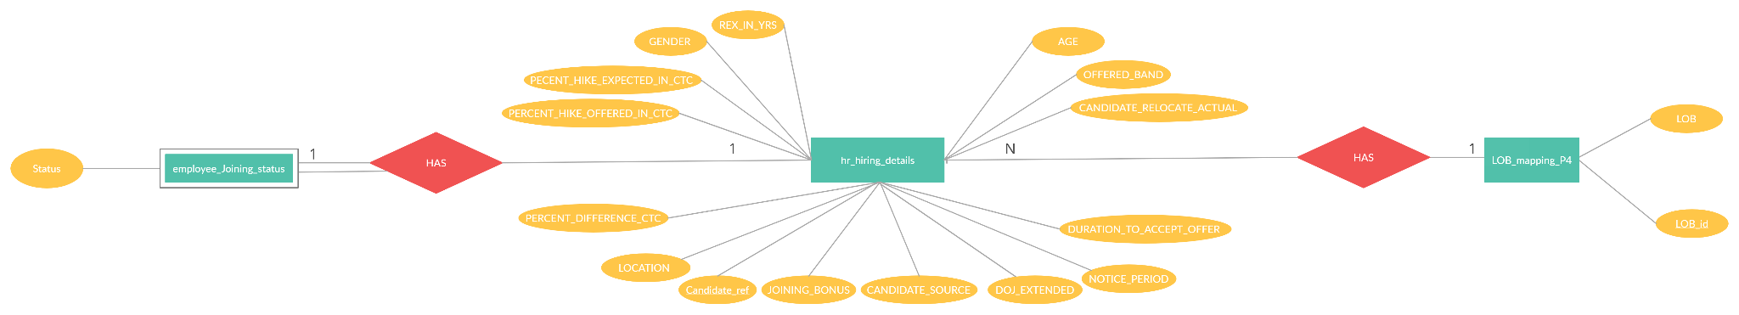
TASK 1.2 (SQL & ORACLE)
The given dataset can be converted into an ER Diagram as follows:

Slide 9
There are 3 tables in the given dataset:
HR_HIRING_DETAILS
LOB_MAPPING_P4
EMPLOYEE_JOINING_STATUS
HR_HIRING_DETAILS is the master table with CANDIDATE_REF as primary key and is a strong entity.
LOB_MAPPING_P4 has the primary key as LOB_ID being the foreign key and is a strong entity, having 1-N relationship with HR_HIRING_DETAILS.
EMPLOYEE_JOINING_STATUS has the primary key as CANDIDATE_REF being the foreign key and is a weak entity, having 1-1 relationship with HR_HIRING_DETAILS.

Slide 10
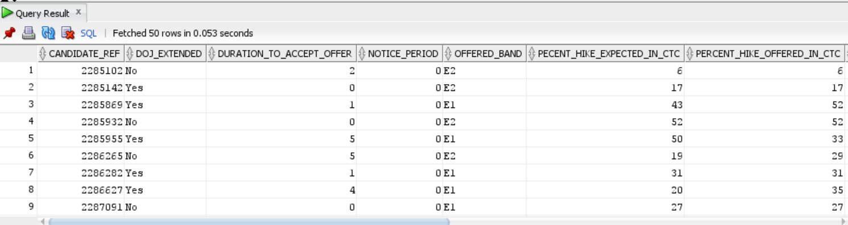
Generate Info those candidates who have accepted offer and joining time is less than 30 days and candidates who are ready to relocate.
select * from hr_hiring_details join employee_joining_status using(candidate_ref) where status='Joined' and notice_period<30 and candidate_relocate_actual='Yes';

Slide 11
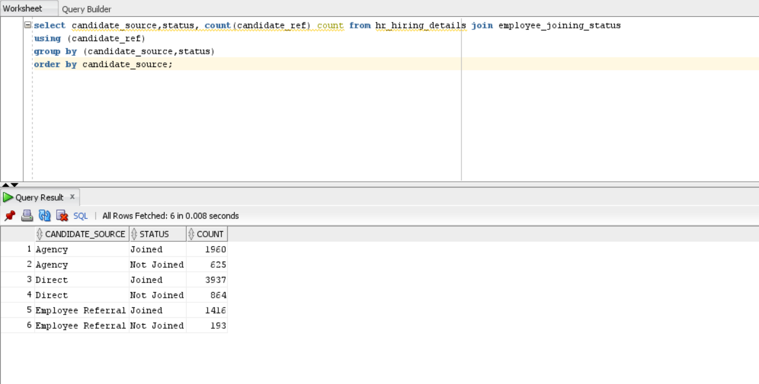
Generate the count of the candidates who are hired through what source and also who have joined and declined the offer.
select candidate_source,status, count(candidate_ref) count from hr_hiring_details join employee_joining_status using (candidate_ref) group by (candidate_source,status) order by candidate_source;

Slide 12
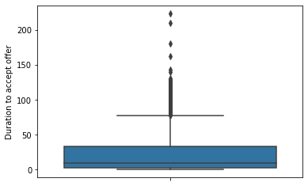
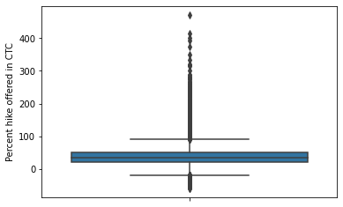
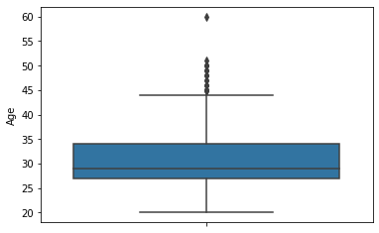
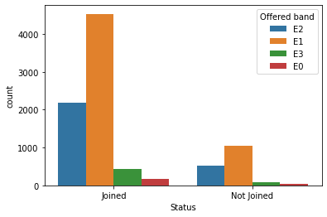
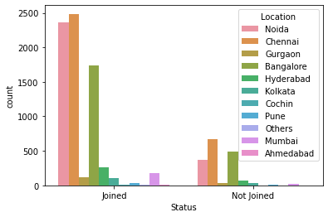
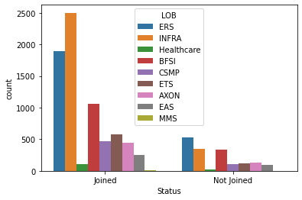
Task 1.3 (Statistical Analysis Using Python)
Descriptive Statistics for Numerical data:

Slide 13
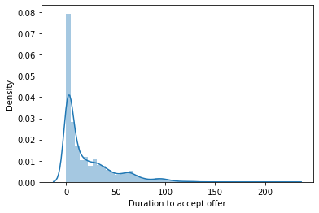
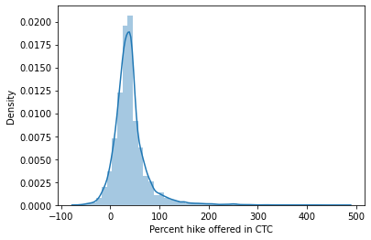
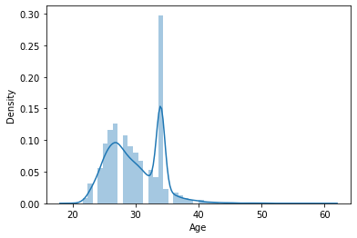
Skewness and Kurtosis
The data is positively skewed it does not follow normal distribution
Duration to accept offer:kurtosis value is less than 3, so it can be said that data is platykurtic
Percent Hike offered in ctc: kurtosis value is more than 3, so it can be said that data is leptokurtic
Age:kurtosis value is less than 3, so it can be said that data is platykurtic

Slide 14
Hypothesis Testing :
The data of the candidates does not follow normal distribution, hence non parametric test is performed on the features
Kruskal Wallis Test was performed for :-duration to accept offer, Percentage Hike in CTC, Age, Notice Period, Years of Experience respectively with the target variable Joining Status
Chisquare test of association was performed for :- Candidate Source, Relocation, Offered Band, LOB, Gender, Joining Bonus, Location
Taking alpha values as 0.05, and testing the pvalue the conclusion of the Hypothesis testing shows:
Features that are associated with the Status
LOB
Location
Relocation
Offered band
Candidate Source
Features that are not associated with the Status
Years of Experience
Notice Period
Age
Hike in Annual CTC
Gender
Joining bonus
Duration to accept the offer

Slide 15
Thank you

